Slide 1
Using real objects and manipulatives to solve problems: A focus on factoring quadratics
Pooja Shivraj, M.S., Ph.D.
Educational Assessment Researcher
Southern Methodist University

Slide 2
Agenda
The mathematical process standards: Why using manipulatives to solve mathematical problems is important
An introduction to the CRA method: an instructional strategy incorporating the use of manipulatives
Intertwining the process standards with mathematical content:
  Using manipulatives and visual representations to factor quadratics
Going beyond factoring quadratics with the CRA method
A brainstorm session on how you can use this method in your classroom

Slide 3
The mathematical process standards
Process standards describe ways in which students are expected to engage in the content; integrated at every grade level and in every course.
There lies an expectation within the Texas Essential Knowledge and Skills for Mathematics (TEKS-M) that students will “select tools, including real objects, manipulatives, paper and pencil, and technology as appropriate… to solve problems.” (Texas Education Agency [TEA], 2012)
The process standards also indicate that students are expected to “…communicate mathematical ideas…using multiple representations…” (TEA, 2012).

Slide 4
The importance of using manipulatives to solve mathematical problems
Stress on using manipulatives in process standards is based on research that demonstrates that using concrete objects to teach abstract concepts can help reinforce students’ understanding of those mathematical concepts
A research-based instructional strategy that can be used to help students grasp and strengthen their understanding of abstract concepts is called the CRA method
Concrete-Representation-Abstract (CRA) – graduated instructional sequence
(Butler, et al., 2003; Flores, 2009; Gersten et al., 2009; Maccini & Hughes, 2000; Maccini & Ruhl, 2000; Miller & Hudson, 2006; Scheuermann et al., 2009; Witzel et al., 2003; Witzel, 2005)

Slide 5
The CRA method
Concrete
Using manipulatives or models
Learning by doing
Representation
Using visual representations like pictures/graphs
Learning by visualizing
Abstract
Using abstract mathematical notation
Learning by translating
1 4
- 2
-----------
1 2
(Gersten et al., 2009)
Notes:
Base 10 blocks

Slide 6
The CRA method for struggling students
NCTM (2000) states that students are required to master skills and meet standards at every grade level, regardless of whether they have a learning disability
Struggling students need enhanced strategies so they can perform at the same level as their peers
Use of the CRA strategy can help bridge the gap between struggling and non-struggling students
(Butler, et al., 2003; Flores, 2009; Gersten et al., 2009; Maccini & Hughes, 2000; Maccini & Ruhl, 2000; Miller & Hudson, 2006; Scheuermann et al., 2009; Witzel et al., 2003; Witzel, 2005)
Notes:
How or why this method would be useful for your struggling students

Slide 7
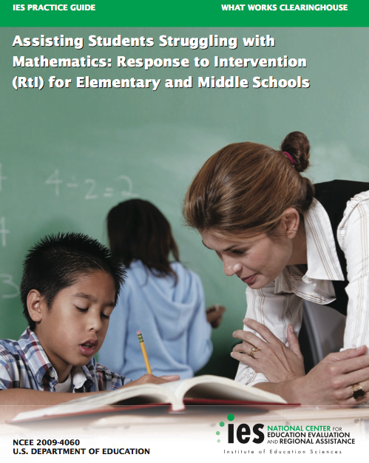
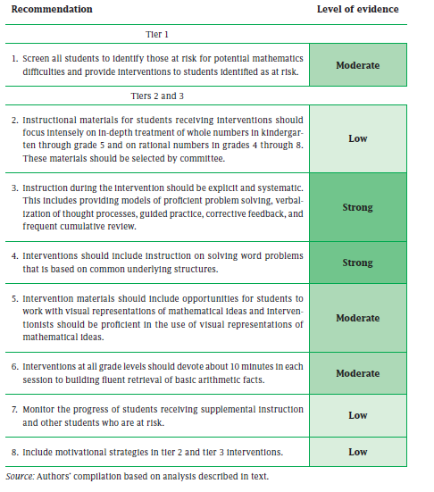
Research-Based recommendations for Tier II interventions
Notes:
*IES conducted RCTs to determine what works/recommendations for assisting students in math

Slide 8
Is the method only for struggling students?
Students differ in the way they process the information presented to them and differ in the way they eventually learn them
Fleming’s (1987) model, most widely used in education, has the following categories:
  Kinesthetic
  Visual
  Reading/Writing
  Auditory
Teaching to each specific learning style has shown to have no effect on student achievement; the CRA method however encompasses different ways that students process information
Most students have a hard time dealing making the transition from arithmetic concepts to abstract algebraic concepts, not just struggling students
Using the CRA method to transition from manipulatives to pictorial representations of them to abstract notation can help all students with learning algebra
(Barbe, et al., 1979; Kolb, 1984; Fleming, 1987; James & Gardner, 1995)
(Rittle-Johnson & Star, 2009)
Notes:
*Candace: even for ELL students – story problems easier than just equations – study by Nathan and colleagues in 2002
*Goldstone & Son 2005 Journal of Learning Sciences Concrete to Abstract more powerful than Abstract

Slide 9
Algebra Tiles
+1
+1
+1
+1
+x
+x
+x²
+x
+1
+1
+1
+x
-1
-x
-x²

Slide 10
Multiplying out expressions
(x + 2) (x + 1)
+ x
+ 1
(x + 1)
+ x
+ x ²
+ x
(x + 2)
+ 1
+ x
+ 1
+ 1
+ x
+ 1
x ²+ 3x + 2
Notes:
connection to prior knowledge – like Hector Reyes said in the morning panel – his son wanted connections through Elementary-Middle-High… quadratics to area models.

Slide 11
Multiplying out expressions
(x - 1) (x + 2)

Slide 12
Factoring Quadratics: Example
x ²+ 5x + 6

Slide 13
Factoring Quadratics: Example
x ²+ 5x + 6

Slide 14
Factoring Quadratics: Example
x + 3
+2 +x
x ²+ 5x + 6
= (x + 2) (x + 3)

Slide 15
Demonstrations
Notes:
Example 1: Positives:
x2 + 3x + 2 = (x+2)(x+1)
Example 2: Negatives
x2 - 5x + 6 = (x-2)(x-3)
x2-4x+3=(x-3)(x-1)
Example 3: ax2
4x2 + 6x + 2 = (2x+1)(2x+2)
Example 4: ax2 with negative
6x2 - 7x + 2 = (2x-1)(3x-2)
Example 4:
x2 – 5x – 6 (x-6)(x+1) – Introduce zero pairs

Slide 16
Translating manipulatives to visual representations
The process standards: Students are expected to: “select tools, including real objects, manipulatives, paper and pencil, and technology as appropriate… to solve problems.” (Texas Education Agency [TEA], 2012)
Lack of constant accessibility of concrete manipulatives
Graduated release of concrete manipulatives
Interpretations of different representations of the same concept – i.e., visualizing quadratics as area models
LET’S DO EXAMPLES!
Notes:
x2 + 7x + 10 =(x+5)(x+2)
4x2+4x+1=(2x+1)(2x+1)

Slide 17
Other Lessons using Algebra Tiles
Expanding or multiplying expressions (e.g., (x + 1)(x +2))
Factoring expressions (e.g., 2x – 6 = 2 (x – 3))
Solving single-step and multi-step equations (e.g., 2x + 2 = 4)
Substitutions (e.g., 2x + 2 when x = -1)
Notes:
*apps to do everything – students need a deeper understanding.

Slide 18
Extending the CRA to concepts beyond algebra
Learning slopes
Rate of change (velocity/drip rate/fill rate)
Can you brainstorm others?
Notes:
distance monitors?

Slide 19
Contact Information
Dr. Pooja Shivraj
Educational Assessment Researcher
Research in Mathematics Education
Southern Methodist University
Email : pshivraj@smu.edu
Phone: (214) 768-7642
Website: http://www.smu.edu/rme
THANK YOU!

Slide 20
References
Barbe, W. B., Swassing, R. H., Milone, M. N. (1979). Teaching Through Modality Strengths: Concepts and Practices. Columbus, Ohio: Zaner-Blosner.
Butler, F. M., Miller, S. P., Crehan, K., Babbitt, B., & Pierce, T. (2003). Fraction instruction for students with mathematics disabilities: Comparing two teaching sequences. Learning Disabilities Research & Practice, 18(2), 99-111.
Fleming, N. D., & Mills, N. D. (1992). Not another inventory, rather a catalyst for reflection. To Improve the Academy, 11, 137.
Flores, M. M. (2009). Teaching subtraction with regrouping to students experiencing difficulty in mathematics. Preventing School Failure, 53(3), 145-152.
Gersten, R., Beckmann, S., Clarke, B., Foegen, A., Marsh, L., Star, J. R., & Witzel, B. (2009). Assisting students struggling with mathematics: Response to Intervention (RtI) for elementary and middle schools (NCEE 2009-4060). Washington, DC: National Center for Education Evaluation and Regional Assistance, Institute of Education Sciences, U.S. Department of Education. Retrieved from http://ies.ed.gov/ncee/wwc/publications/practiceguides/
James, W.; Gardner, D. (1995). Learning styles: Implications for distance learning. New Directions for Adult and Continuing Education, 67, 19-32.
Kolb, D. (1984). Experiential learning: Experience as the source of learning and development. Englewood Cliffs, NJ: Prentice-Hall.
Maccini, P., & Hughes, C. A. (2000). Effects of a problem-solving strategy on the introductory algebra performance of secondary students with learning disabilities. Learning Disabilities Research & Practice, 15(1), 10-21.
Maccini, P., & Ruhl, K. L. (2000). Effects of a graduated instructional sequence on the algebraic subtraction of integers by secondary students with learning disabilities. Education and Treatment of Children,23(4), 465-489.
Miller, S. P., & Hudson, P. J. (2006). Helping students with disabilities understand what mathematics means. TEACHING Exceptional Children, 39(1),28-35.
National Council of Teachers of Mathematics. (2000). Principles and standards for school mathematics. Reston, VA: Author.
Rittle-Johnson, B., & Star, J. R. (2009). Compared with what? The effects of different comparisons on conceptual knowledge and procedural flexibility for equation solving. Journal of Educational Psychology, 101(3), 529.
Scheuermann, A. M., Deshler, D. D., & Schumaker, J. B. (2009). The effects of the explicit inquiry routine on the performance of students with learning disabilities on one-variable equations. Learning Disability Quarterly, 32(2), 103-120.
Witzel, B. S., Mercer, C. D., & Miller, M. D. (2003). Teaching algebra to students with learning difficulties: An investigation of an explicit instruction model. Learning Disabilities Research and Practice, 18(2), 121-131.
Witzel, B. S. (2005). Using CRA to teach algebra to students with math difficulties in inclusive settings. Learning Disabilities: A Contemporary Journal, 3(2), 49-60.

