Slide 1
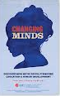
Mathematical Problem Solving in Real World Situations
Dr. Candace Walkington
Assistant Professor, Simmons School of Education and Human Development
Southern Methodist University

Slide 2
The TEKS Process Standards
The process standards weave the other knowledge and skills together so that students may be successful problem solvers and use mathematics efficiently and effectively in daily life.
Students will apply mathematics to problems arising in everyday life, society, and the workplace.
What does this really mean? What does it NOT mean?

Slide 3
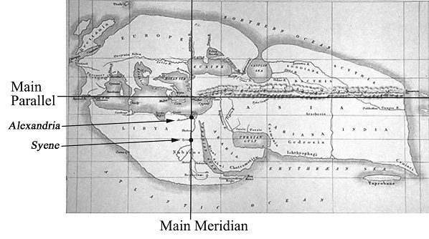
The circumference of the Earth
Mathematician and astronomer Eratosthenes read that in the city of Syene, at noon on June 21, a vertical meter stick (length = 1 meter) cast no shadow.
However, he observed that on the same day and time in the city Alexandria, which is 800 kilometers due north of Syene, a meter stick cast a shadow of length 0.122 meters.
Using only this information, Eratosthenes was able to figure out the circumference of the earth. Can you reproduce his steps using high school geometry?
Notes:
40,075 km

Slide 4
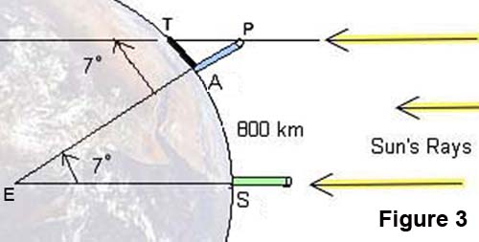
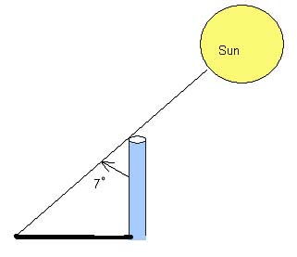
When am I ever going to use this?
Relationships between sides and angles in a right triangle (sine, cosine, tangent)
Alternate interior Angles Theorem
Properties of a circle
Proportional relationships

Slide 5
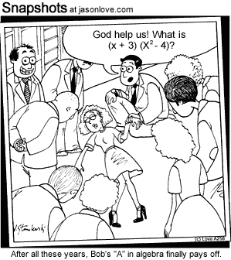
Algebra in the “Real World”
https://www.youtube.com/watch?v=qNACe-wp3u8#t=89
IS ALGEBRA NECESSARY?: “A typical American school day finds some six million high school students and two million college freshmen struggling with algebra. In both high school and college, all too many students are expected to fail. Why do we subject American students to this ordeal? I’ve found myself moving toward the strong view that we shouldn’t. Think of math as a huge boulder we make everyone pull, without assessing what all this pain achieves.” ~ New York Times, 2012

Slide 6

Algebra in the “Real World”
The distance in feet that a machine called the Crawler has traveled from its hangar is given by the equation y = 4x+175, where x is the number of seconds the machine has been moving. In how many more seconds will the Crawler be a total of 275 feet from the hangar?
What could the “4” represent in the given situation?
What could the “175” represent?
http://vimeo.com/109405701
Walkington, Sherman, & Petrosino (2012), Journal of Mathematical Behavior
Notes:
“It could have already started at 4 feet... and 175 could equal the time it took for it to go 4 feet.”
Start off with Why Algebra?

Slide 7

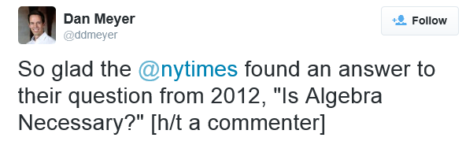
Algebra in the “Real World”
Michael Cieply for The New York Times (2014):
“The Interview generated roughly $15 million in online sales and rentals during its first four days of availability, Sony Pictures said on Sunday. Sony did not say how much of that total represented $6 digital rentals versus $15 sales. The studio said there were about two million transactions overall.”

Slide 8

Why do we need Research studies?
Instead of abandoning entire math courses altogether, maybe we could instead learn to teach them better?
Many of the innovations and principles that educators believe are effective aren’t actually effective when people study them empirically
For example, research has conclusively shown that matching instruction to students’ learning styles has absolutely no effect on their achievement
In addition, there are ways to do innovations well, and ways to do them poorly (e.g., the Crawler problem).
Research tells us how something should be implemented, and how it might function differently for different groups of students.

Slide 9
Study 1
Which problem type was easiest and which was hardest for 9th grade Algebra I students?
Equation | Word Equation | Story Problem
Solve for x: x × 6 + 66 = 81.90 | Starting with some number, if I multiply it by 6 and then add 66, I get 81.90. What number did I start with? | When Ted got home from his waiter job, he multiplied his hourly wage by the 6 hr he worked that day. Then he added the $66.00 he made in tips and found he had earned $81.90. How much does Ted make per hour?
Koedinger & Nathan (2004), The Journal of the Learning Sciences

Slide 10
Study 2
Which group of students learned more? (all lasted same amount of time)
How do results like these compare to the organization of high school textbooks? (Walkington, Sherman, & Howell, accepted with revisions)
Concrete Only | Abstract Only | Abstract to Concrete | Concrete to Abstract
Taught mathematical principle using concrete scenario (ants and food) | Taught principle using abstraction only (dots/ abstract shapes) | Taught principle using abstraction then concrete afterwards | Taught principle using concrete scenario and then abstraction afterwards
Goldstone & Son (2005), The Journal of the Learning Sciences

Slide 11
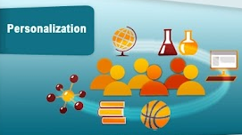
What is Personalization?
Instruction is tailored to the specific interests of different learners
U.S. Department of Education, National Education Technology Plan, 2010
Student interested in movies
Introduced to systems through “The Interview” problem scenario from the New York Times

Slide 12
Why Personalization?
Video removed (sensitive data)
Becoming “Instagram Famous”
Walkington, Sherman, & Howell (2014), Mathematics Teacher
Notes:
Students tracked into lowest math class

Slide 13
Why Personalization?
Video removed (sensitive data)
Making Lego Stop Motion Videos
Walkington, Sherman, & Howell (2014), Mathematics Teacher

Slide 14
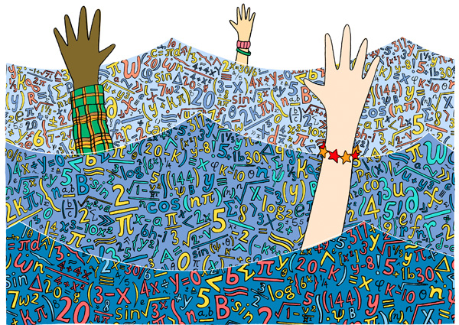
Purpose
Students have rich engagement with their interest areas (e.g., Walkington et al, 2014)
Students often don’t make sense of school-based math, and attitudes towards math decline over adolescence (e.g., Frenzel et al., 2009)
How can we engage students in understanding the mathematical ideas they encounter in school?
Explore opportunities offered by personalized learning

Slide 15
Study 3
145 Algebra I students,1 unit in Cognitive Tutor Algebra
Random assignment to:
  Control: Normal problems
  Experimental: 1 of 4 personalized versions of same problems, based on interests survey
Performance: Significantly improved expression-writing; significantly greater impact for struggling students
Efficiency: Significantly reduced time writing symbolic expressions
Transfer: Maintained performance and efficiency gains in next unit
Normal | A particular assembly line in an automobile company plant can produce thirteen cars every hour.
Computer | A recent video blog you posted about your life on YouTube gets thirteen hits every hour.
Food | Your favorite restaurant "Steak 'n Shake" sells thirteen caramel pretzel shakes every hour.
Cell Phones | On your new iPhone 5 you send your best friend thirteen texts every hour.
Walkington (2013), Journal of Educational Psychology

Slide 16
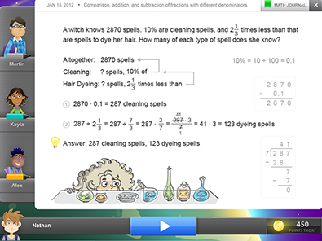
Study 4
254 sixth grade students in Reasoning Mind
Randomly assigned to 4 conditions:
  1) Normal tasks
  2) Random personalized tasks
  3) Personalized tasks based on survey
  4) Personalized tasks based on choice
In short term, all personalized performed better; in long term, only choice condition gained
Effects magnified for low initial interest/state test
Walkington & Mingle (under review), AIED 2015
Notes:
Transition: Need deeper personalization at a smaller grain size, in addition to increased ownership. How can this be feasible?

Slide 17


Study 5
Association between problem topics and performance on math story problems in large pre-existing datasets
  Curricula (Cognitive Tutor, MATHia) – 8th & 9th grade
  Standardized tests (NAEP, TIMSS) – 4th & 8th grade
LIWC counted words in different topic categories (e.g., leisure, money, motion, food)
Problems that were easier: social, home, family, leisure
Problem that were harder: physics/motion, finance, business, healthcare
Walkington, Clinton, Ritter, & Nathan (in press), Journal of Educational Psychology

Slide 18
Study 6
Middle/high school students
Pull-out sessions where posed and solved algebra story problems on linear functions based on interests
Pre/post assessments of expression-writing and interest in algebra
Even students with little exposure to algebra could reason about and write a linear function in the context of their interests
Sizable gains in expression-writing and interest in algebra
Walkington & Bernacki (under review), Journal of Mathematical Behavior

Slide 19
Summary
Personalization interventions should seek to:
Effects may not be seen at all if these principles are not honored
Various logistical constraints and trade-offs limit implementation of principles
Depth
Make deep, meaningful connections to the ways students use quantitative reasoning
Grain Size
Know the interests of individual learners
Ownership
Allow students to control the connections made to their interests
Richness
Balance rich problem-solving with explicit connections to abstractions afterwards
Notes:
Make SMARTART

Slide 20
How Can I do this?
Get to know your students’ interests by talking to them
Get to know how high school mathematics is used in different domains like art, music, science, engineering, nature, astronomy, architecture, etc.
  Museum of MADI and Geometric Art
  Perot Museum of Nature and Science
  Dallas Arboretum Rory Meyer’s Children’s Adventure Garden
  Workshops (CSI/Infinity Summer workshop at SMU, Perot)
  MMT/MSTEM Graduate courses at SMU
Investigate excellent lesson resources (handout)
Choose your textbooks carefully (surface versus deep connections; sequencing) – Core-Plus Mathematics, UCSMP, Cognitive Tutor, CPM

Slide 21
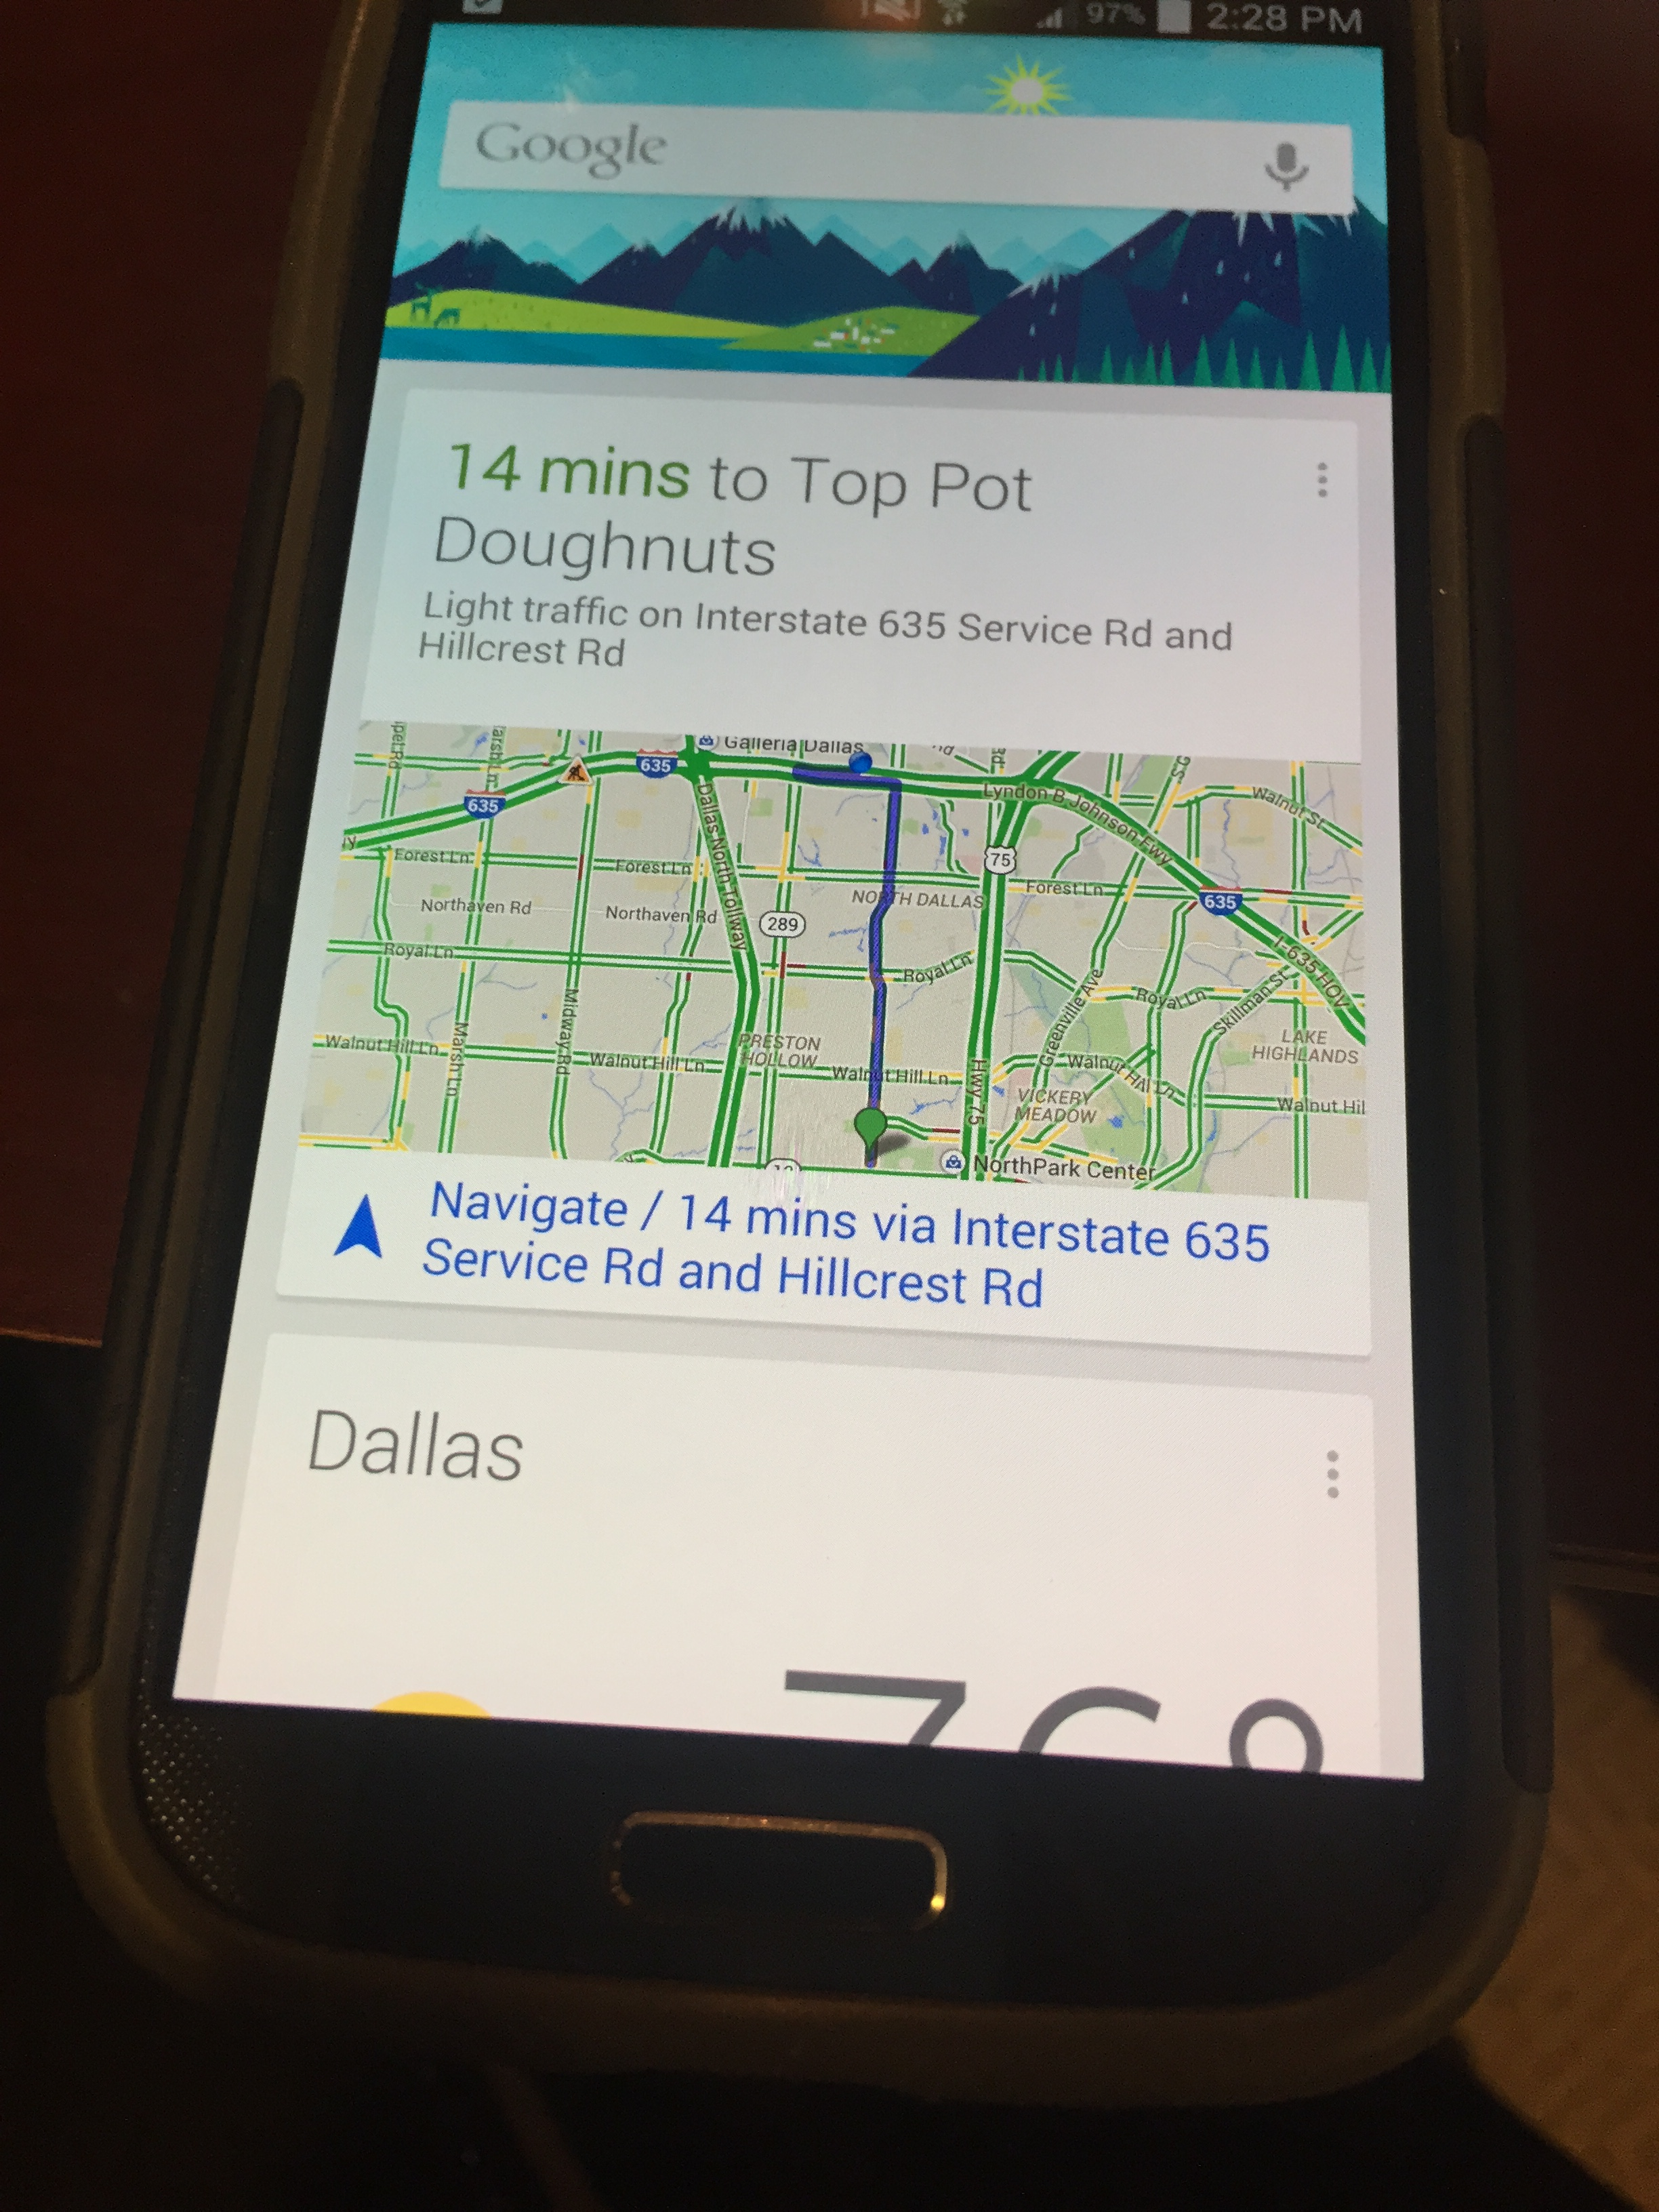
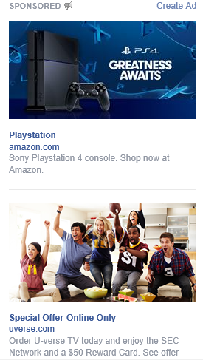
What might the future hold?
Smart Technology – devices collect enormous user data
“Gets to know” the learner over time
Works in conjunction with teacher to formulate and structure authentic investigations related to interest areas
Provides personalized resources and feedback
Learners explore and develop new interests in academic and non-academic subjects
Collaborate with learners of similar or dissimilar interests
Learners see “funds of knowledge” being used and valued in academic domains

Slide 22
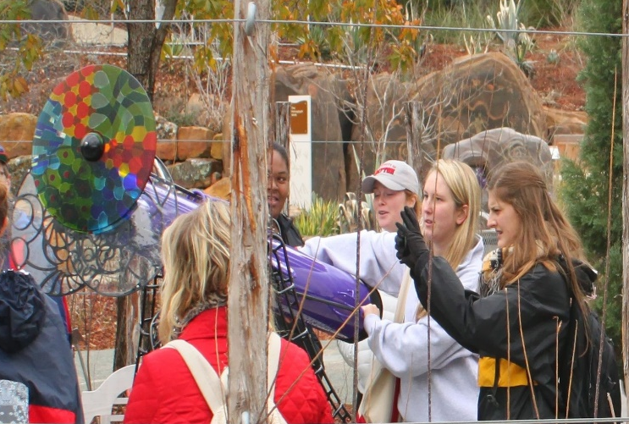
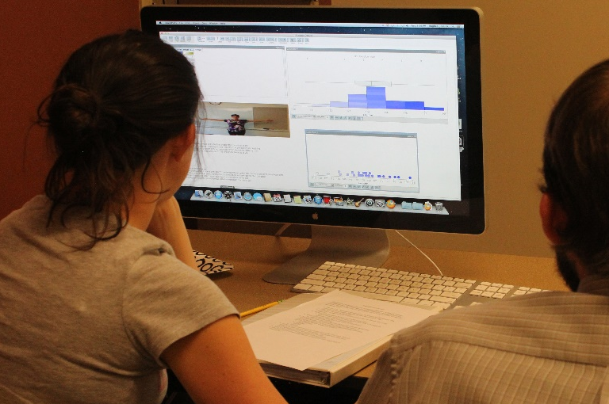
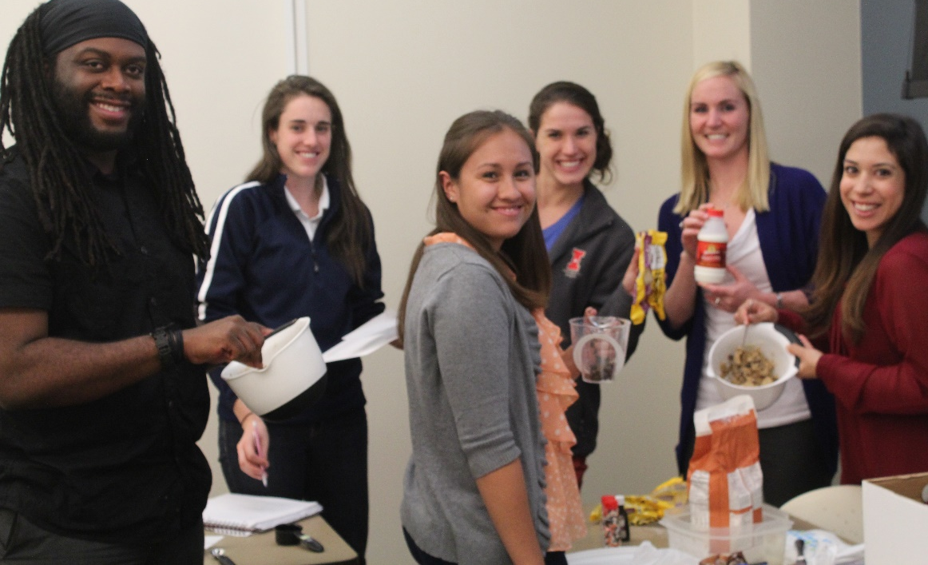
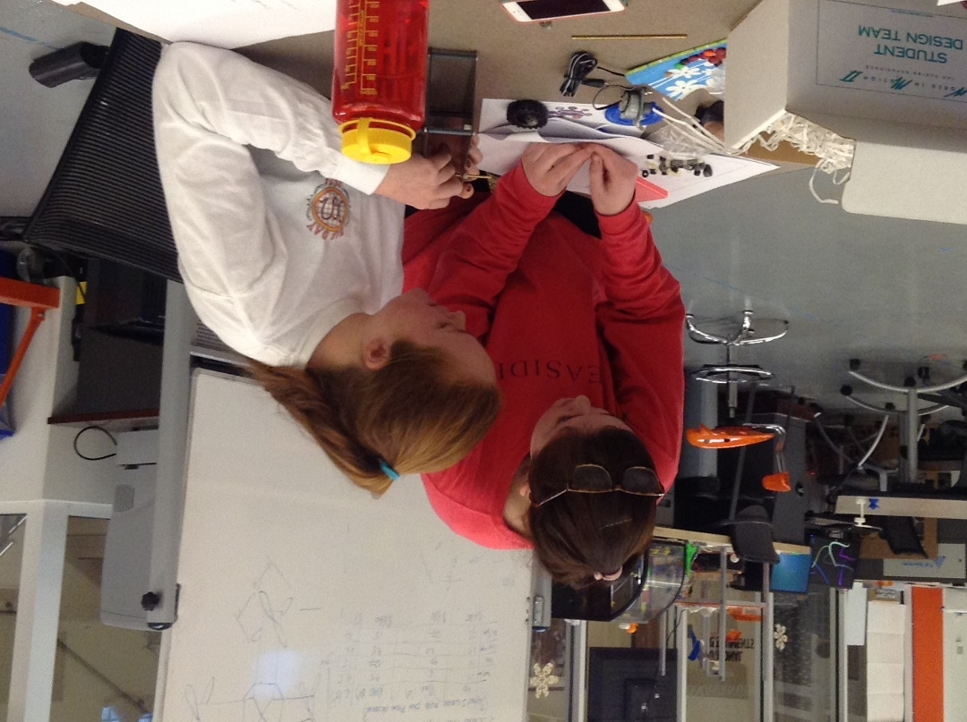
Master Mathematics Teacher Program @ SMU
Take 4 courses in K-12 mathematics teaching at SMU, and receive a “Master Mathematics Teacher” certificate
Courses provide resources for hands-on learning, student assessment, and engaging mathematical tasks
Courses also count towards a Master’s degree in Education
More information: cwalkington@smu.edu or www.smu.edu/mmt

Slide 23
Master STEM Teacher Program @ SMU
Take 4 courses in K-12 STEM teaching at SMU
Courses provide resources for hands-on learning, student assessment, and engaging STEM tasks
Courses also count towards a Master’s degree in Education
More information: cwalkington@smu.edu or www.smu.edu/mmt

Slide 24
Guiding discussion questions
What are some exceptional activities you’ve done in your classroom to embed high school mathematics in real world contexts?
What activities have you done that connect instruction to students’ interests?
What are some of the challenges of making real world connections in high school classes?
What questions do you have about the research findings for making real world connections in high school math?
Where can I find resources to support this? How can I tell quality resources from resources that implement this poorly?

