Slide 1
Concur Non-Travel Reporting

Slide 2
Table of Contents
Icon Key: 3
Concur Login: 4-5
Home Page: 6-7
Manage Expense Page: 8-9
Creating Expenses: 10-25
Reimbursement: 10-18
Card Charge: 19-21
Submitting: 22-25
Attendees: 26-30
Local Mileage: 31-35
Itemizing: 36-39
Allocating: 40-42
Missing Receipt: 43
Detailed Report: 44
Approval Flow: 45
Approver’s View: 46-48
Questions?: 49

Slide 3
Icon Key
Missing Receipt
Receipt Attached
Allocation has been made
Comment has been made
Missing Receipt Affidavit Attached
Attendee List included
Important message (see top)
Hard Stop (see top to see message- something missing)
Itemization Exists (Click arrow to open list)
Itemizations Have been Allocated

Slide 4
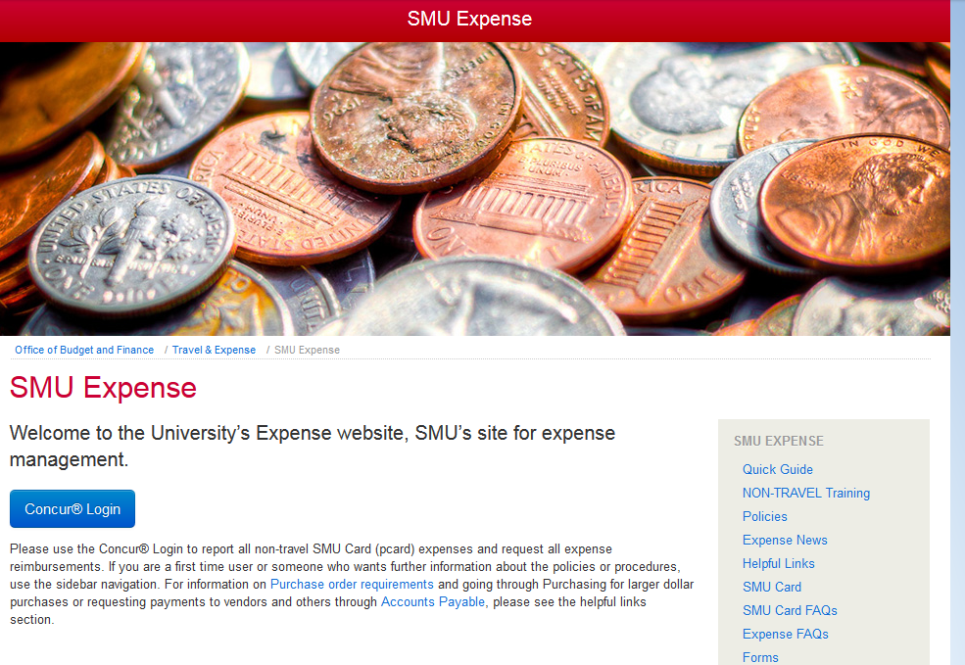
Concur Log In
To log in go to www.smu.edu/expense
Click on Concur Login

Slide 5
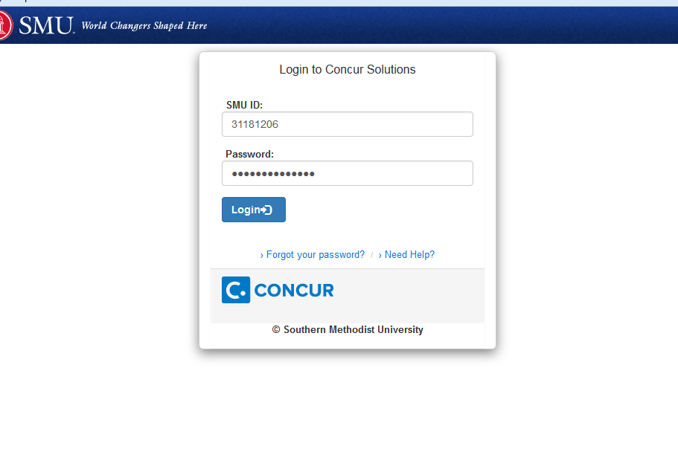
Enter your SMU ID# and your system password

Slide 6
Home Page
This is the area you will spend most of your time in and can access the available expenses and open reports here as well.
If you are an approver this is where your requests for approval come in
If you have an SMU Card, this is where your charges will post
This is a list of all open reports that have not been submitted

Slide 7
1.) click on Expense
You can also access your expenses by clicking on the Available Expenses on the second menu bar or on the bottom of your home screen

Slide 8
Manage Expenses Page
This page has your active reports, List of available expenses, and uploaded receipts area. Active Reports: You will see your most current submitted reports as well as anything you are working on. When it is time to create a Non-Travel expense report, click on the box marked “Create New Report”. If you want to see history of your reports, click on “Report Library” to the right.

Slide 9
Available Expenses- If you have an SMU Card or you name your expense with your mobile App, it will appear here as a list
Available Receipts- You have to option to add receipts to your receipt bank until ready to use. Click on the box

Slide 10
Creating a New Non-Travel Report
Click on Create New Report Box and another box will pop up

Slide 11
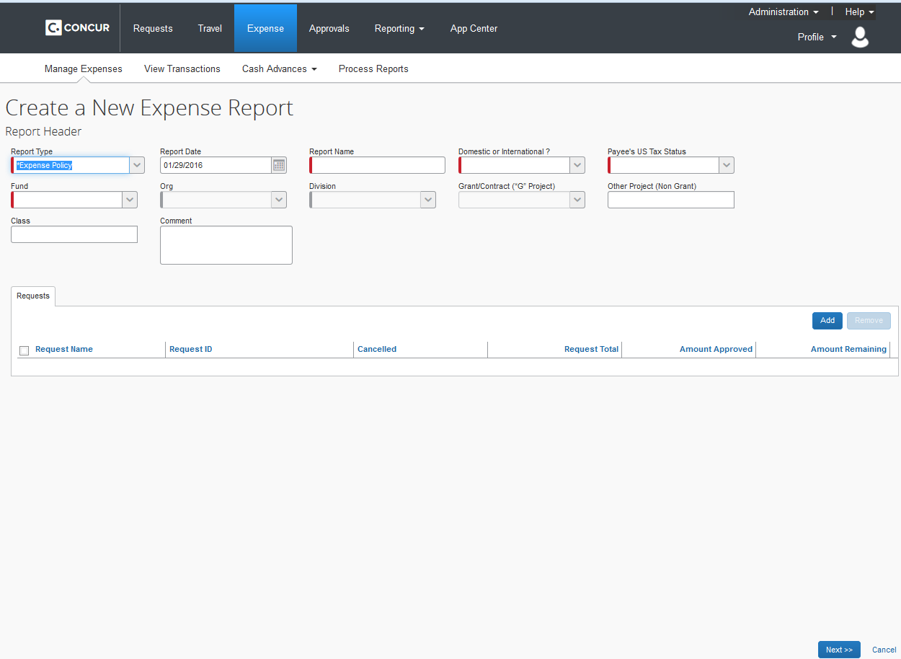
*Tips: when a drop box is present, you must select the value from the drop box even if you type the value in. This becomes very important when adding your org values.
The box that pops up is your header box. This box sets the defaults to your report. You will need to complete the fields marked with red. The first field –Report Type- For Non-Travel mark Expense Policy
Report Name will be something that helps you remember in what time the charges are from. Fund/Org values- This is the default of the entire report , but individual charges can be assigned their own fund/org value. When done entering your values, skip the middle section and select NEXT

Slide 12
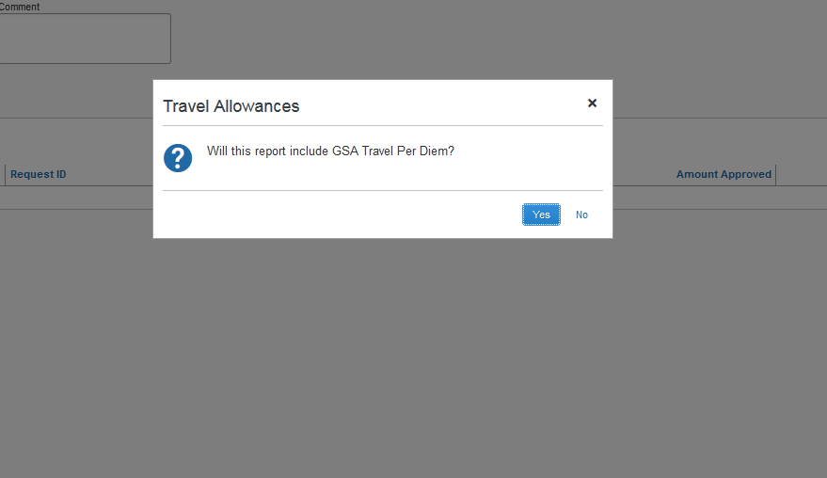
This option is for travel only, select NO

Slide 13
Building Your Report: + New Expense
Only use this option when a reimbursement is due back to you for an out of pocket expense

Slide 14
When adding a reimbursable expense, select the + New Expense button.
To the right you will see expense types, select one that goes with the type of expense you have

Slide 15
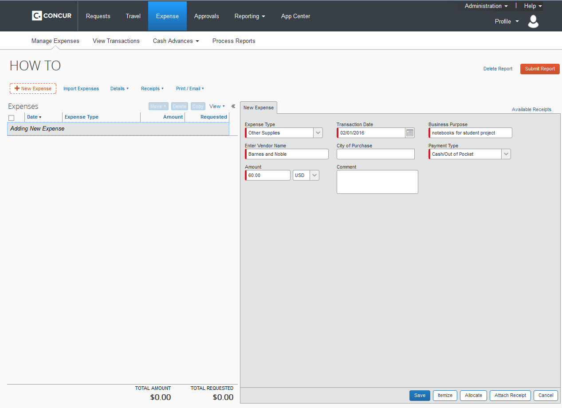
Fields will appear on the right. Fill in required ones marked with red. Notice the payment type is “Cash/Out of Pocket” if this is an SMU credit card charge you know that you have done something wrong.
You can now attach your receipt by going two different routes- both give you the option to upload from desktop

Slide 16
Receipts will be in the available box if already uploaded or you can select Upload and browse your desktop

Slide 17
After uploading your receipt into your receipt bank, find the receipt you would like to attach to this charge and select the icon on the receipt you would like and then save

Slide 18
Your reimbursement will appear on the left. Depending on the type of reimbursement you are seeking, more fields may be required, attendees, etc… you can now continue to add an necessary reimbursements or card charges.

Slide 19
Building Your Report: SMU Credit Card Charges
To add SMU Card charges to your report- Click on Import Expenses. ***Never add an expense for a card charge. If it does not show up under Import Expenses, it has not posted yet, WAIT***

Slide 20
This box will appear on the right with all available card charges. Select the items you want to move into your report by clicking the box to the left of the charge, then select move – to current report

Slide 21
The charge(s) will then move to the left. Select the charge to edit and add receipts. When you select it will open to the right. Fill in boxes marked with red, then add receipts and save. Refer to slide 14 for adding receipts.

Slide 22
When you have added all reimbursements and/or card charges you are going to on this report and icons are blue and there are no errors, submit report

Slide 23
Select Accept & Submit

Slide 24
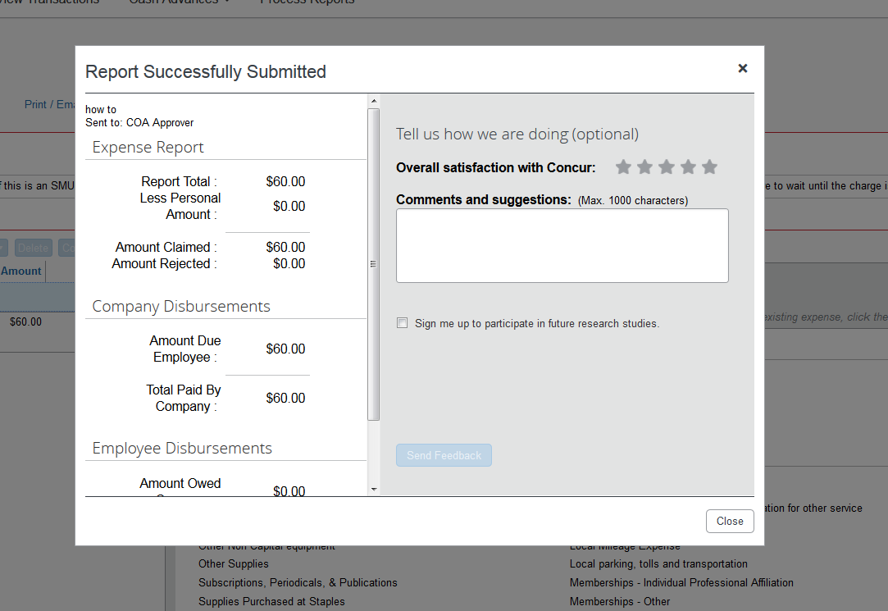
Select Close

Slide 25
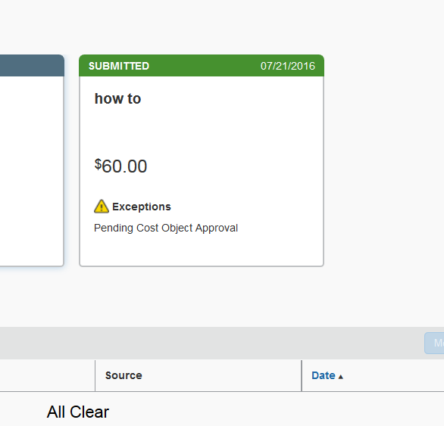
You will then be taken back to the Manage Expense page where you started. Your report will be in submitted status. Pending Cost Object Approval means it has gone to the org owner(s) for approval.

Slide 26
Adding Attendees
There are 4 ways to add attendees: New Attendee, Advanced Search, Favorites, and Import

Slide 27
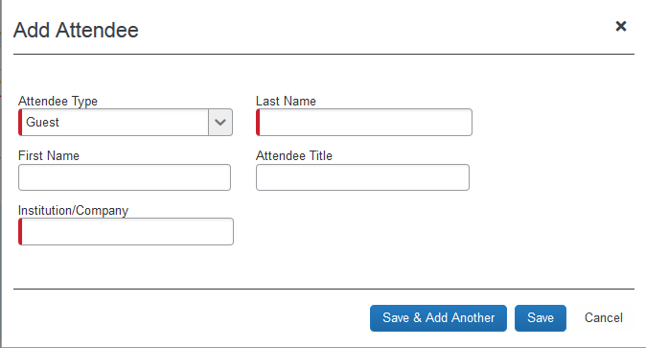
New Attendee
In this option, you can add guests, spouses/partner, or students
Select from drop down box on attendee type and fill in the required fields in red
Then Save & Add Another if more or Save

Slide 28
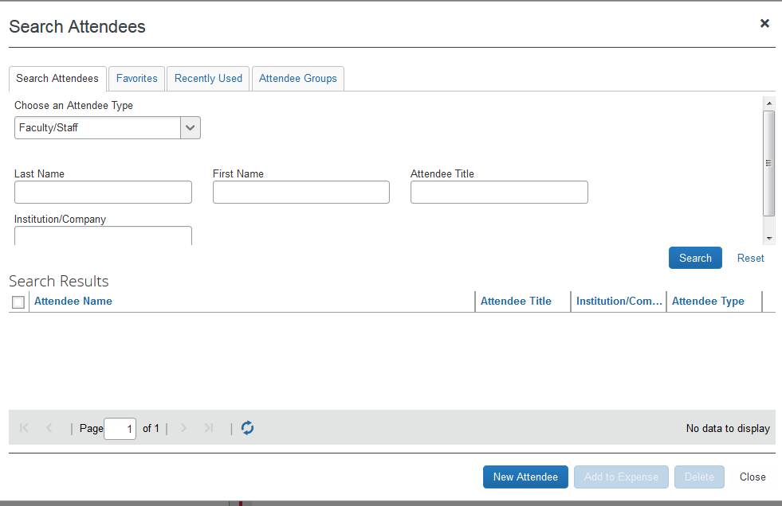
Advanced Search
This allows you to search for faculty and staff
Enter attendee type from drop down and enter last name-search and you can select option- Add to Expense

Slide 29
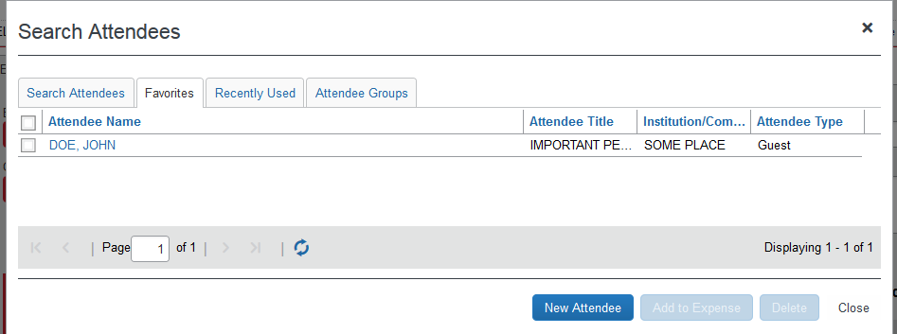
Favorites
This list is full of the attendees you have previously used.
Just find the person you are looking for and click the box next to their name- Add to Expense

Slide 30
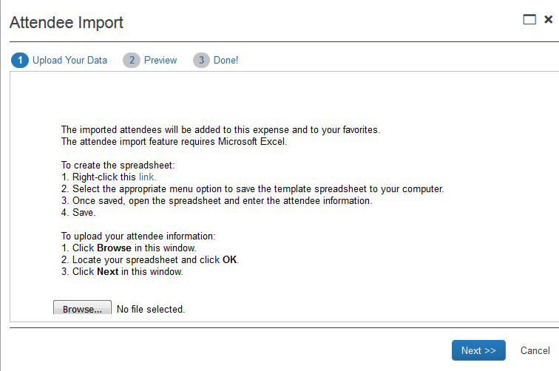
Import
Follow the directions on the pop up box
Save the template-You must use the template format for Concur to accept the import
Once you are done entering your information, save the template and then upload it to Concur

Slide 31
Local Mileage Reporting
Add new expense- Local Mileage Expense

Slide 32
Local Mileage Reporting
Fill in fields that are marked red. For locations info – select Mileage Calculator

Slide 33
Local Mileage Reporting
Enter your way points- after you enter your from and to an option will appear to make round trip. When you are finished click Calculate Route, then Add Mileage to Expense

Slide 34
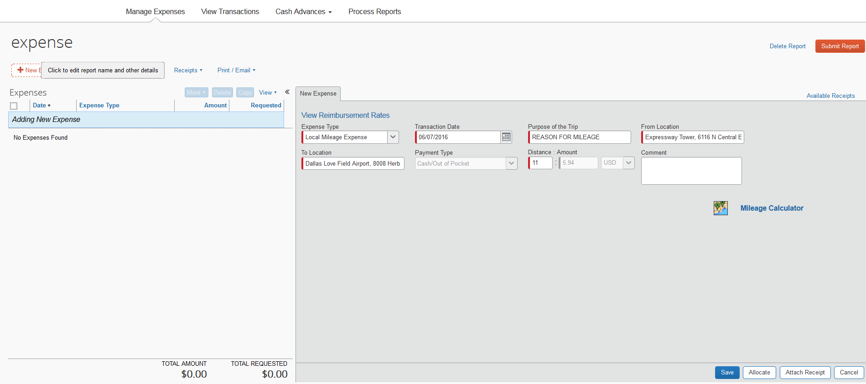
Local Mileage Reporting
The Mileage Calculator will calculate your mileage with current reimbursement rate.
Save- No receipt is required.

Slide 35
Local Mileage Reporting
Expense will show up on the left side and will be a “cash out of Pocket” payment type

Slide 36
Itemizing
Hint: if you have both itemizing and allocating to do on the same charge, itemize first then allocate or you will lose your allocation if done first
To itemize your expense click itemize

Slide 37
Itemizing
Select Expense Type for this itemization from the drop down

Slide 38
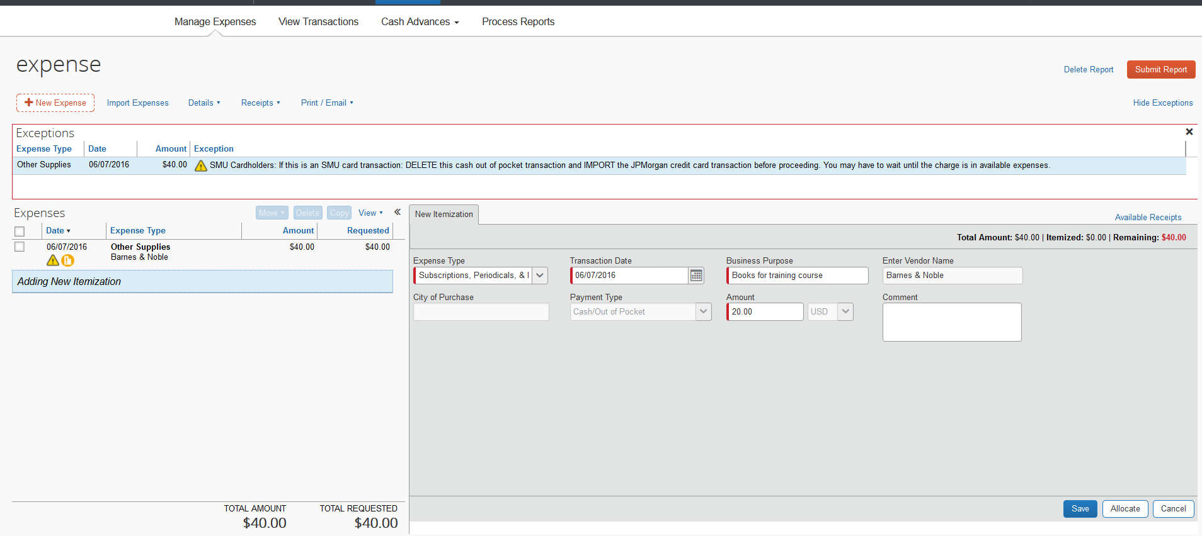
Itemizing
More boxes will appear – fill in the amount you are wanting go with your selected expense type- Save

Slide 39
Itemizing
The itemization will be added to the left under the original expense. Repeat until itemizations equal the amount of the original expense. You can then allocate each itemization by clicking on the line and opening it to the right.

Slide 40
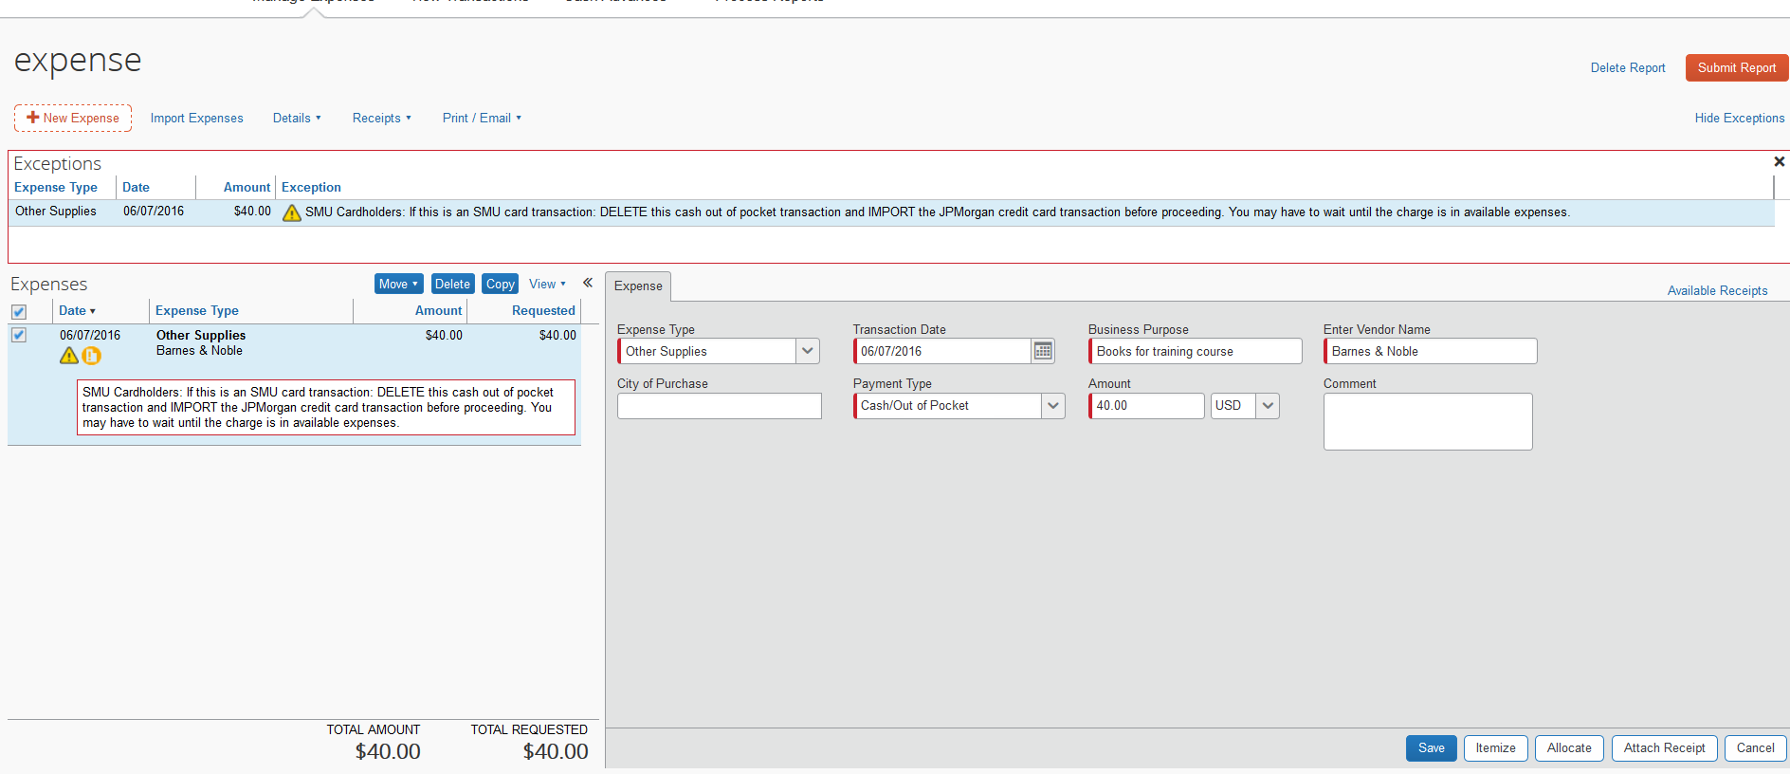
Allocating
To Allocate your expense to different orgs click on Allocate. A separate box will pop up.

Slide 41
Allocating
When this box pops up you can add however many lines you are going to need for each org assignment
You can select how you would like to allocate by- amount or percentage. When done click save, then ok, then done

Slide 42
Allocating
When allocation saves an icon representing it will show up under the charge on the left

Slide 43
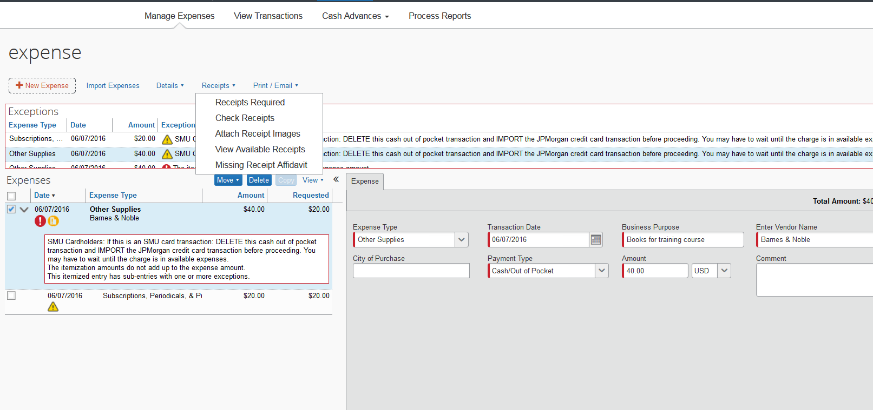
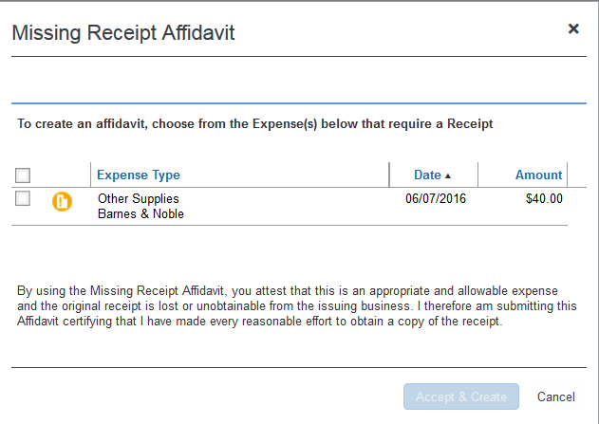
Missing Receipt Affidavit
Only one item per report is allowed a missing receipt affidavit
An attempt must be made to get a reprint of the receipt from the merchant
To add a missing receipt affidavit go to receipts in the menu- select Missing Receipt Affidavit, select charge to apply it to- Accept & Create
This will create the following icon on the charge

Slide 44
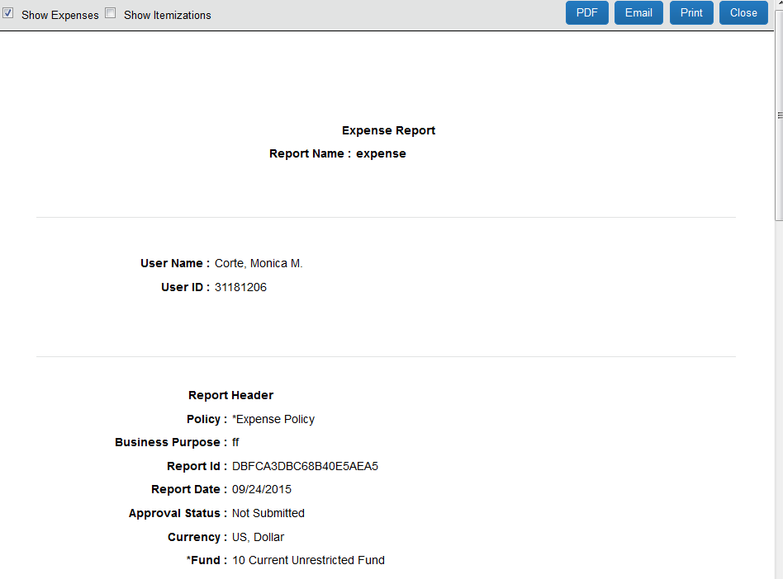
SMU Detailed Report
SMU Detailed Report is a summary of the entire report and can be printed, emailed, or saved as a PDF
This report allows you to view all the charges and their allocations. Go to Print/Email and select Detailed Report
Once the report opens, select Show Itemizations at the top

Slide 45
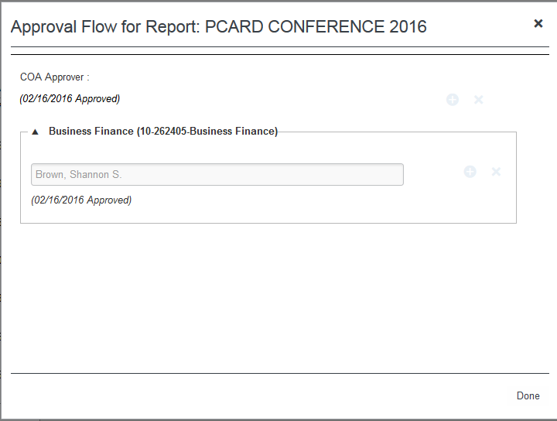
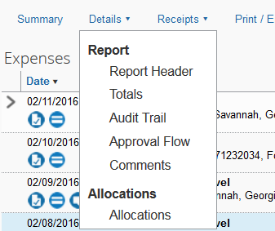
Approval Flow
After you have submitted your report, you can see who the approval flow will involve. Go back into your report, go to Details in the menu and select Approval Flow. A box will pop up with a list of approvers depending on how many orgs the report is allocated to. It will list the approver and underneath, the date they approve

Slide 46
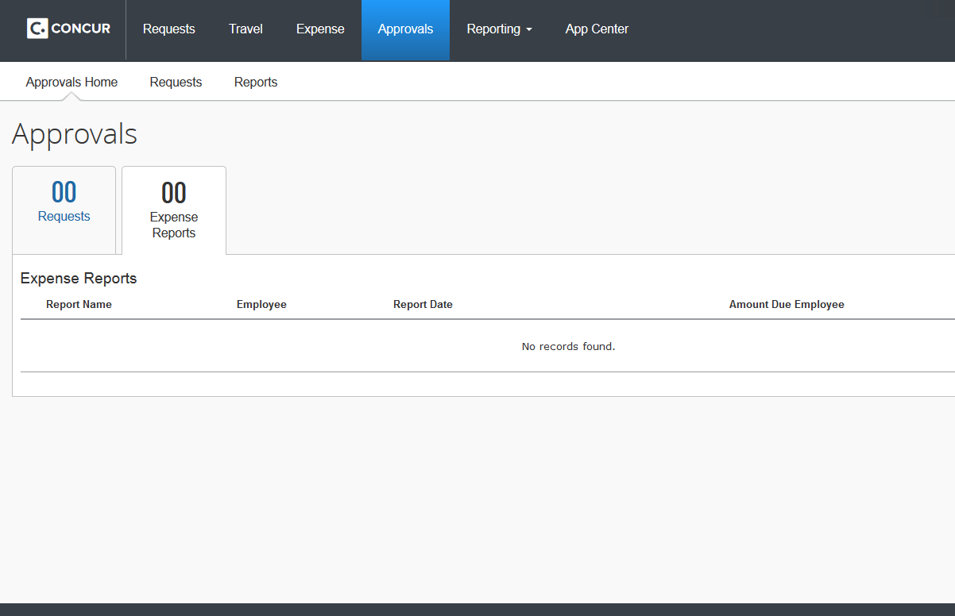
Approver’s View
To approve a report that was charged to your org, go to the Approvals Tab at the top of your profile
This will take you to any approvals you have pending

Slide 47
Approver’s View
Open the report
Concur allows the approver to see all transactions on the report regardless of whether or not they are charged to the approver’s org
The Cost Object Approved Amount is what the approver is responsible for. This is located in the bottom left hand corner of the opened report. This may include one org or multiple orgs they may own that are applied to the report
A good way to view the charges that are on the approver’s org is to pull the SMU Detailed Report- Slide 44

Slide 48
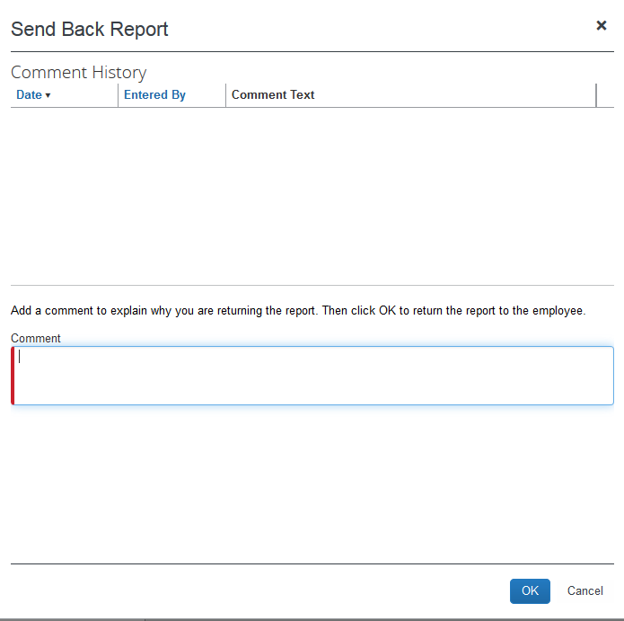
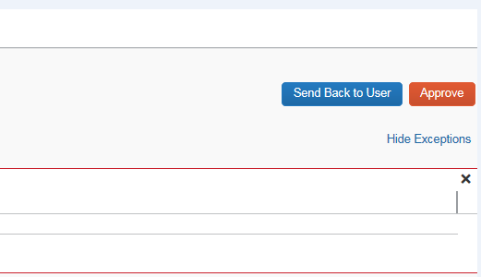
Approver’s View
After evaluation, approval or reject can be made
Send Back to User pops up a text box for comments to the report owner

Slide 49
Questions?
Concur Administrator
Millicent Grant
travel@smu.edu
214-768-2800
East Campus- Expressway Towers
6116 N Central Expressway Suite 205A
Dallas, TX 75216

